Slide 1
Capstone Engagement
Assessment, Analysis, and Hardening of a Vulnerable System
By: Derek Anderson

Slide 2
Table of Contents
This document contains the following sections:
01
Network Topology
02
Red Team: Security Assessment
03
Blue Team: Log Analysis and Attack Characterization
Hardening: Proposed Alarms and Mitigation Strategies
04

Slide 3
Network Topology
‹#›

Slide 4
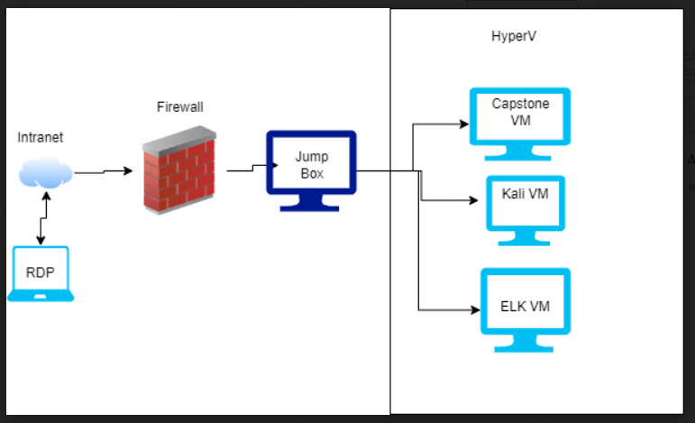
Network Topology
Network
Address Range:192.168.1.0/16
Netmask:192.168.1.255
Gateway:192.168.1.1
Machines
IPv4:192.168.1.1
OS: Windows
Hostname:ML-REFVM-684427
IPv4: 192.168.1.105
OS: Linux
Hostname: Capstone
IPv4: 192.168.1.90
OS: Linux
Hostname: Kali
IPv4: 192.168.1.100
OS: Linux
Hostname: ELK

Slide 5

Red Team
Security Assessment
‹#›

Slide 6
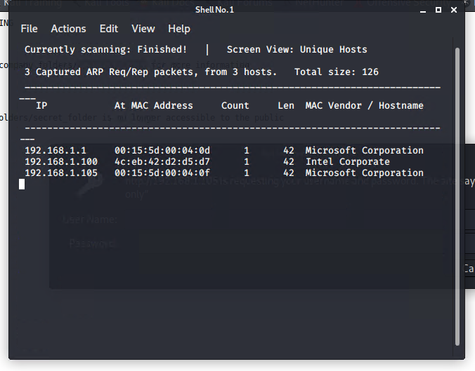
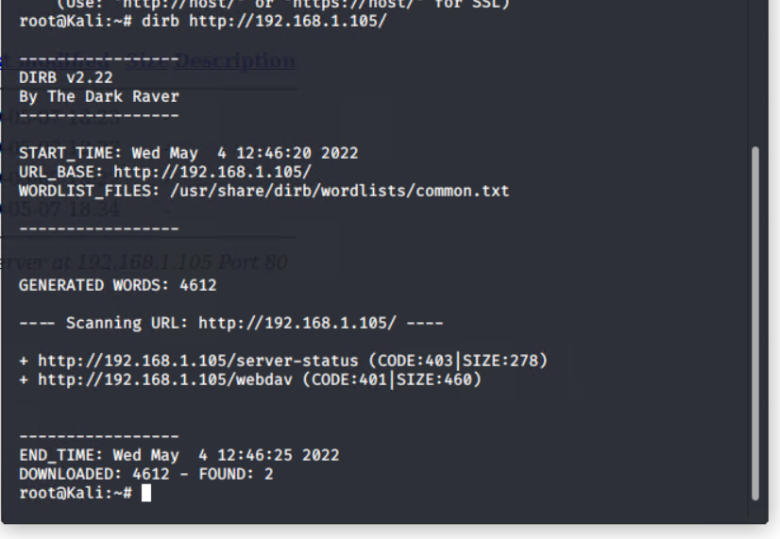
Reconnaissance

Slide 7
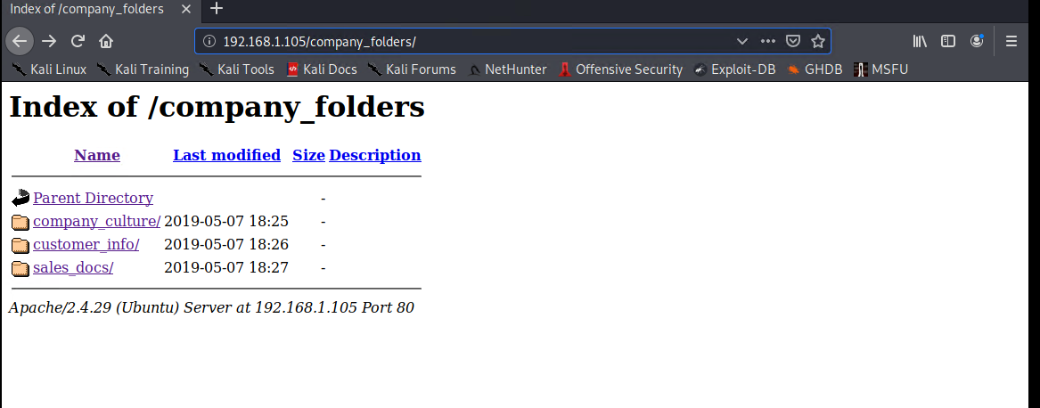
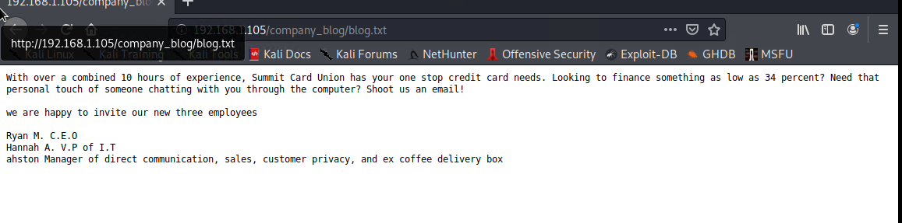
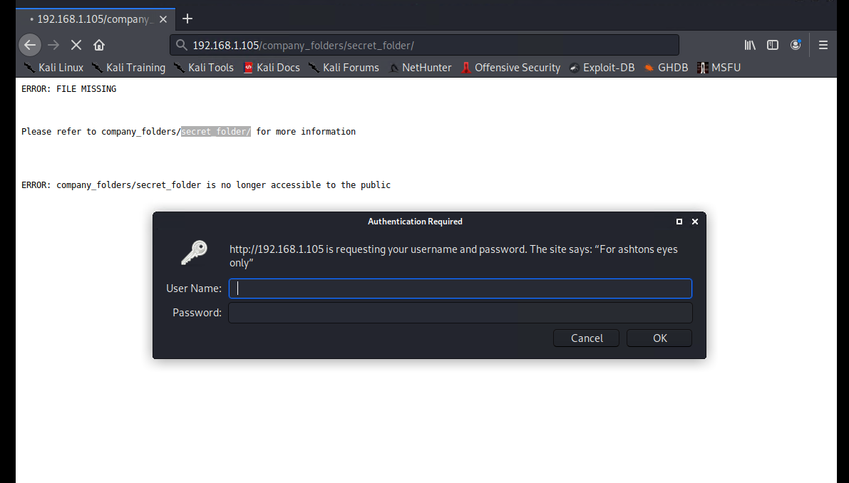
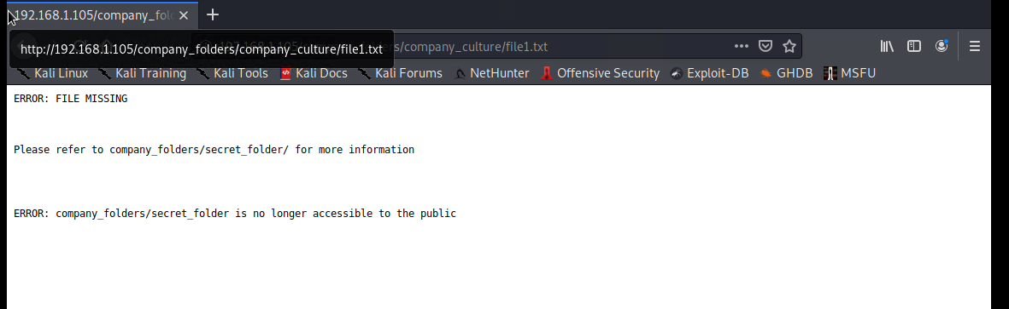
Reconnaissance

Slide 8
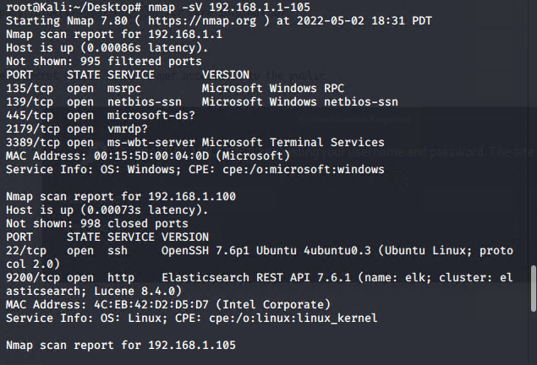
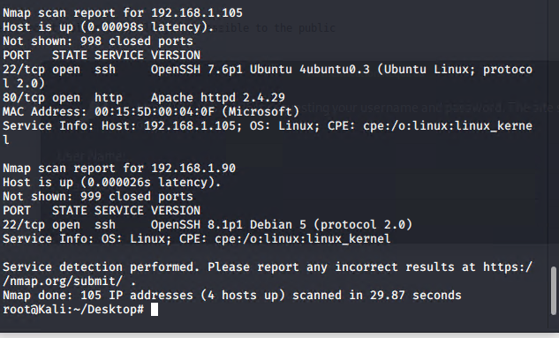
Scanning

Slide 9
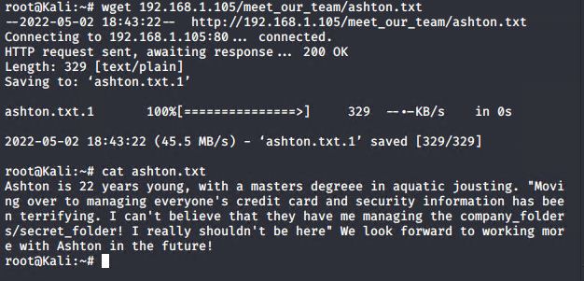
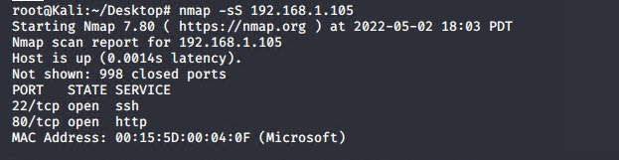
Scanning

Slide 10
Recon: Describing the Target
Nmap identified the following hosts on the network:
Hostname | IP Address | Role on Network
Capstone | 192.168.1.105 | Web Server
Kali | 192.168.1.90 | Pen Testing
ELK | 192.168.1.100 | SIEM system
ML-REFVM-684427 | 192.168.1.1 | NAT

Slide 11
Vulnerability Assessment
The assessment uncovered the following critical vulnerabilities in the target:
Vulnerability | Description | Impact
CVE-2016-2944 Brute Force Vulnerability. Although this may not be the exact CVE I found that it had similar properties to the one found in the exercise. | Allows the attacker to attempt to log into an account with no limitations on attempts. | Using this vulnerability an attacker would be able to gain access to a user account. And once in the users account they could make changes to the system.
Weakness in Login Credentials and exposed critical information. | Allows for passwords to easily be guessed or for hashes to easily be cracked. | By having passwords that can easily be cracked Admin user Ryans account was able to be breached.
CVE-2008-1734 Shellshock/reverse shell. I chose this CVE because it most closely resembled what we did in the engagement. | Allows attacker to cause a denial of service attack using a simple shell attack. | Shell shock allows attacker to create a reverse shell and from there they can access the whole system. And alter any file they choose.

Slide 12
Exploitation: [Brute Force Vulnerablity]
01
02
03
Tools & Processes
Once I found the User names on the web site in the “company_blog/blog.txt”. I saw that Ashton was an admin user. I then used Hydra to perform the brute force attack.
Achievements
Through this exploit I was able to find the password for Ashton and then I was able to access “/company_folders/secret_folder/”.
Link to command and results
hydra

Slide 13
Exploitation: [Weakness in Passwords/ exposed information]
01
02
03
Tools & Processes
By using the information found from the previous exploit I found a hash of system admin Ryan.
The tool I used was “CrackStation”
Achievements
By using this I was able to find Ryans password and with his password I was able to move forward to the next phase of attack because I had gained higher privileges on the network.
Commands and outputs
Cracking the hash

Slide 14
Exploitation: [Shell Shock/ Reverse Shell]
01
02
03
Tools & Processes
I then created a payload using msfvenom.
Once the payload was created I delivered the payload using the access that I got from Ryan’s account. Using WebDav.
I then used Meterpreter to create a reverse shell with the payload that I created with msfvenom.
Achievements
I was able to create the reverse shell and from there search the files on the target machine and was able to find the flag.
Process and commands
Msfvenom
Meterpreter setup
Searching Meterpreter
The Flag

Slide 15
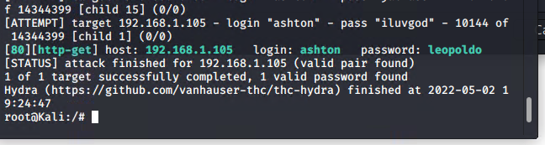
Exploitation using Hydra

Slide 16
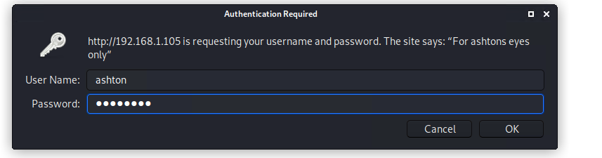
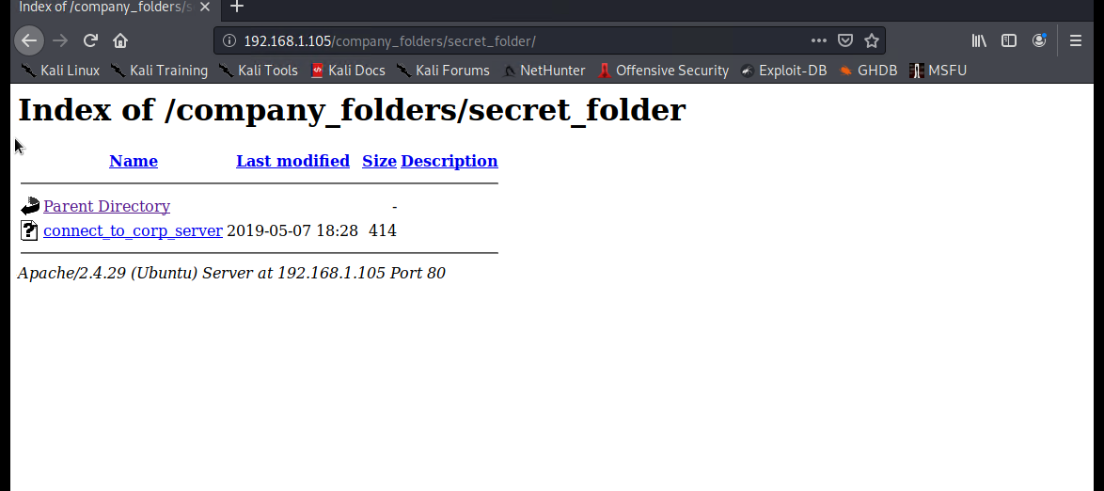
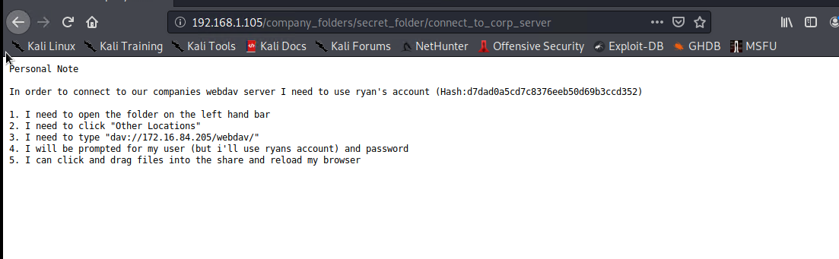
What I found

Slide 17
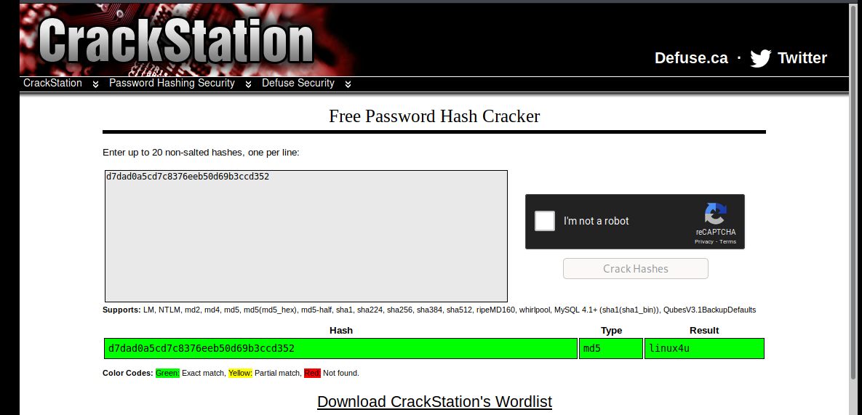
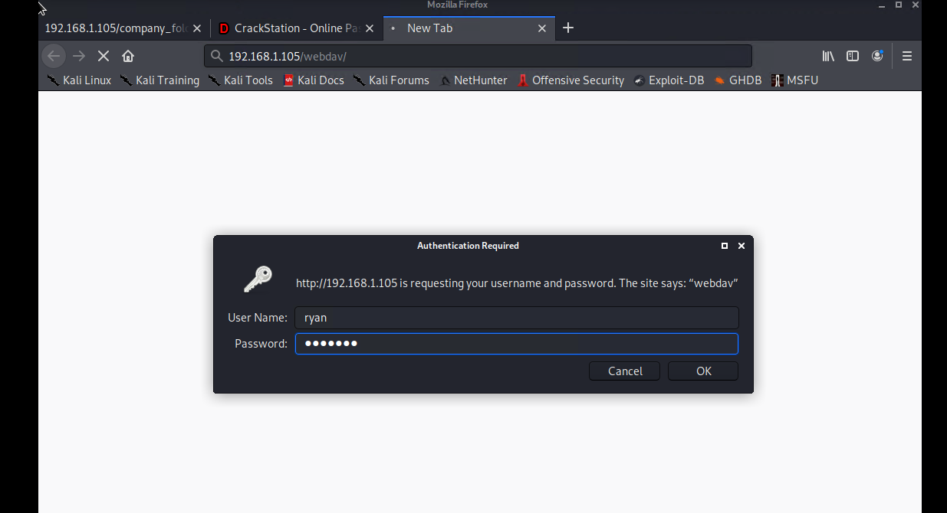
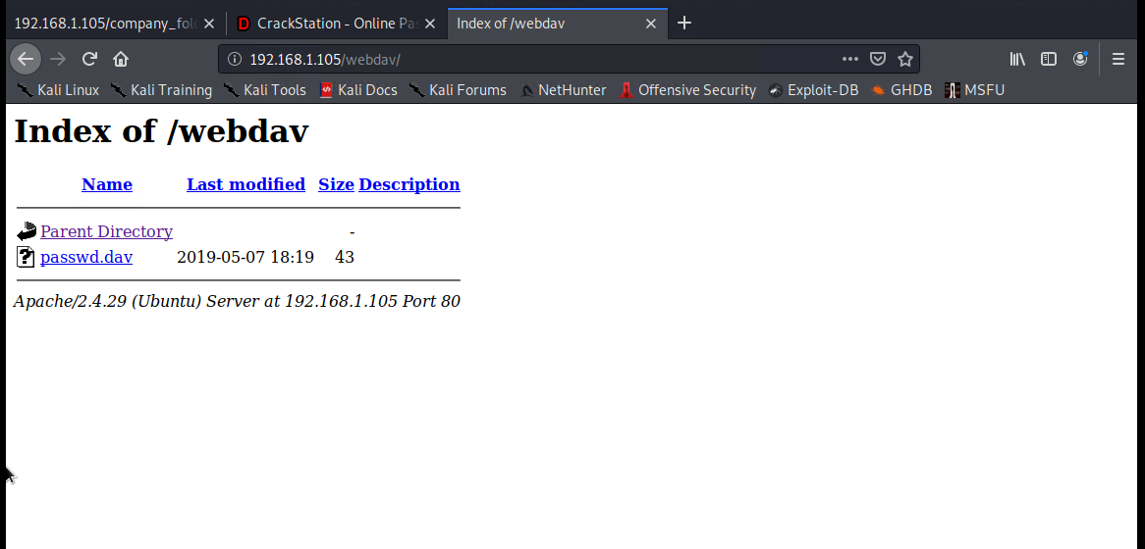
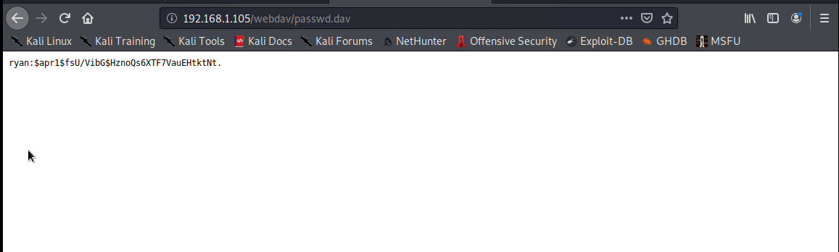
Exploitation- Cracking the hash

Slide 18
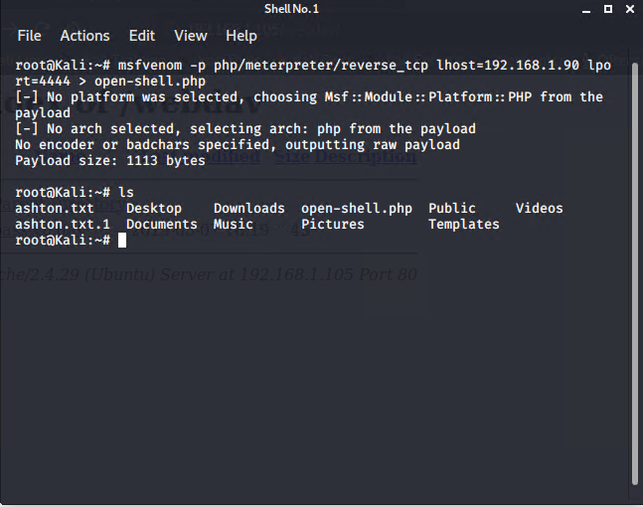
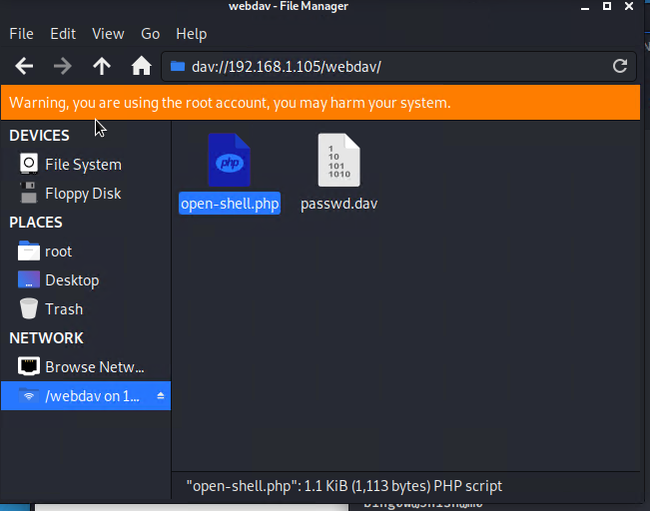
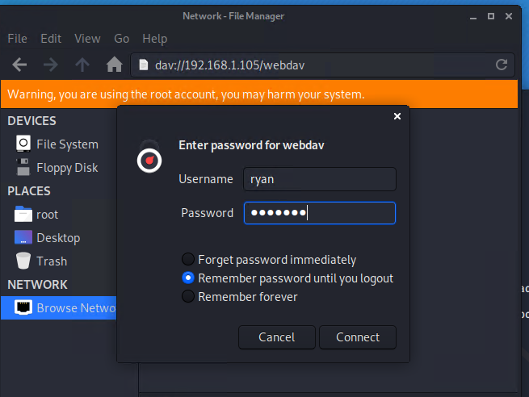
Payload

Slide 19
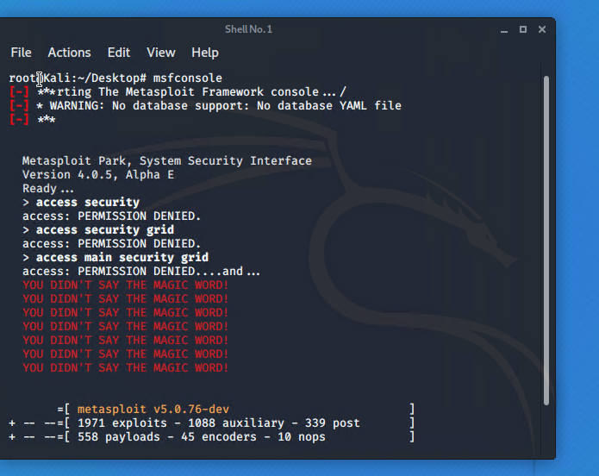
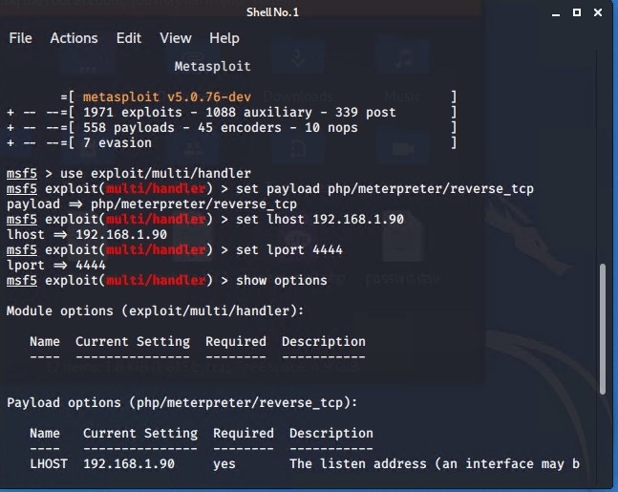
Meterpreter

Slide 20
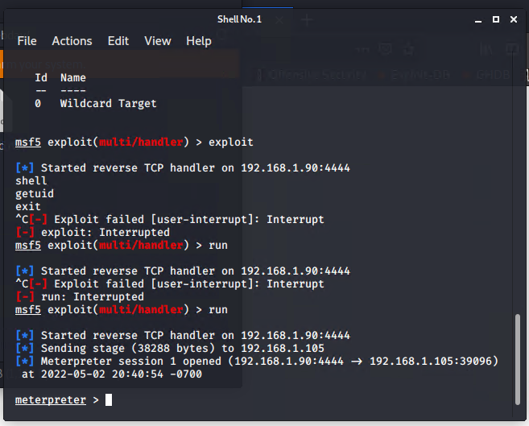
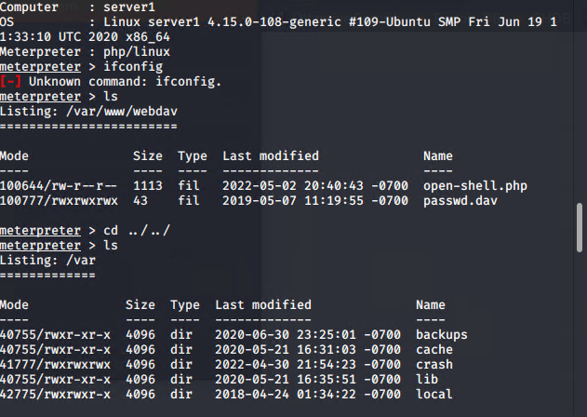
Meterpreter finding the flag

Slide 21
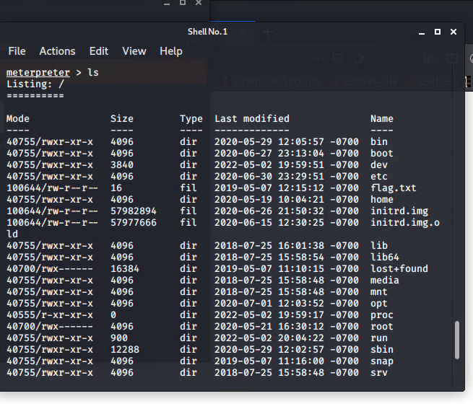
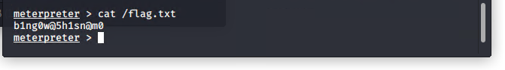
The Flag

Slide 22

Blue Team
Log Analysis and Attack Characterization
‹#›

Slide 23
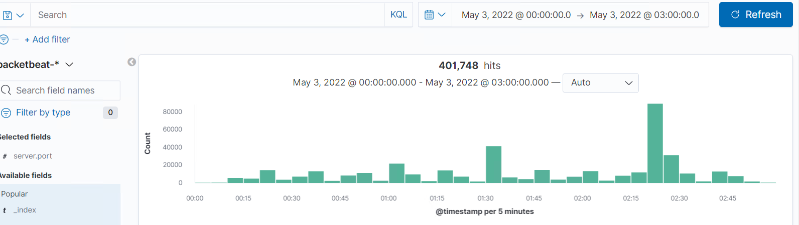
Analysis: Identifying the Port Scan
This port scan took place on May 3, 2022 at 02:59.
There was a total of 401748 packets sent. They were sent from IP 10.0.0.201.
You can tell that this is a port scan because of the high volume of ports scanned in a short period of time.

Slide 24
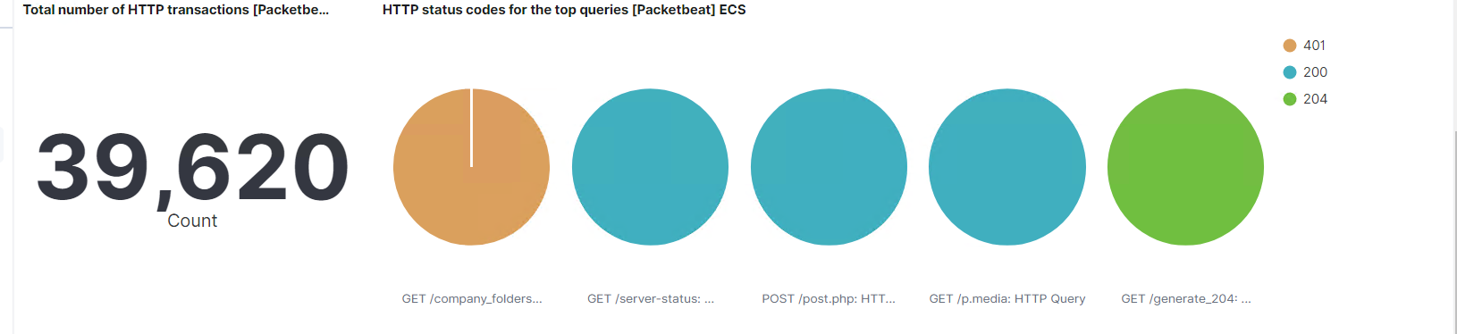
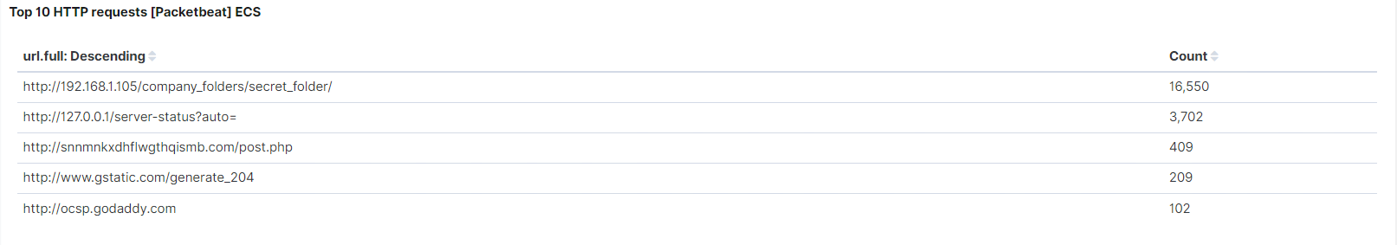
Port Scans Continued

Slide 25
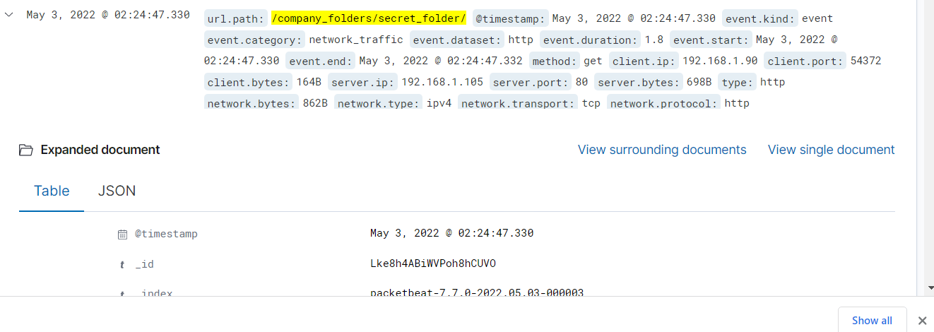
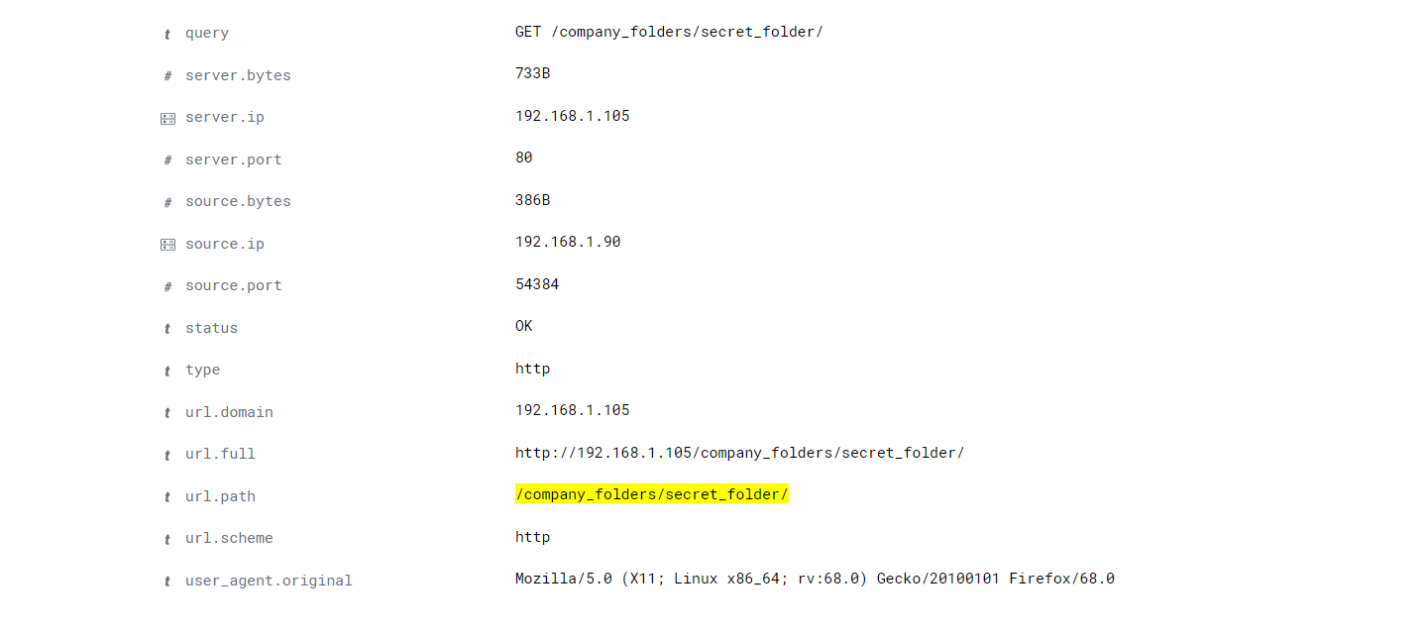
Analysis: Finding the Request for the Hidden Directory
The request occurred on May 3, 2022 at 02:24:47. There were a total of 16544 request made.
The file that was requested was the “/company_folders/secrets_folder/” The folder contained information about a user “Ashton” and a way to login.

Slide 26
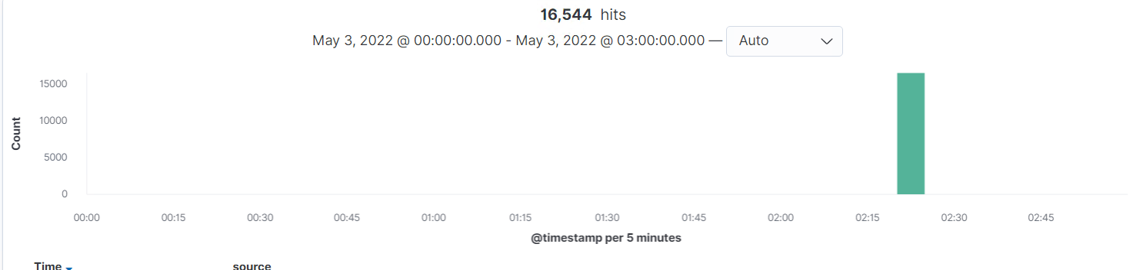
Request for hidden Directory Continued

Slide 27
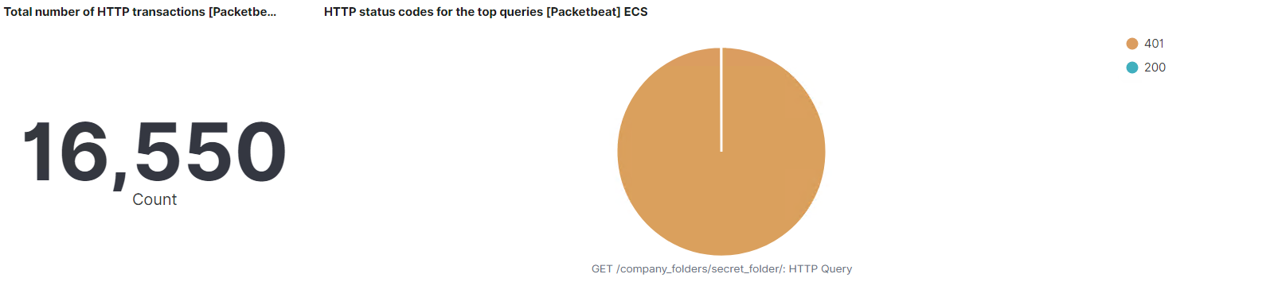
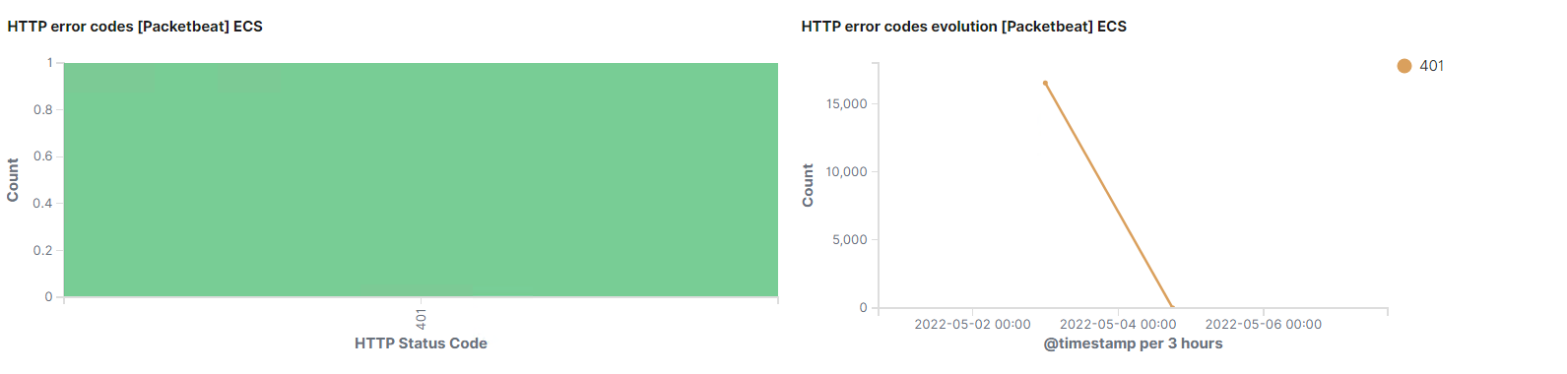
Analysis: Uncovering the Brute Force Attack
Notes:
There was a total of 16550 request made.
There were 16534 request made before the attacker discovered the password.

Slide 28
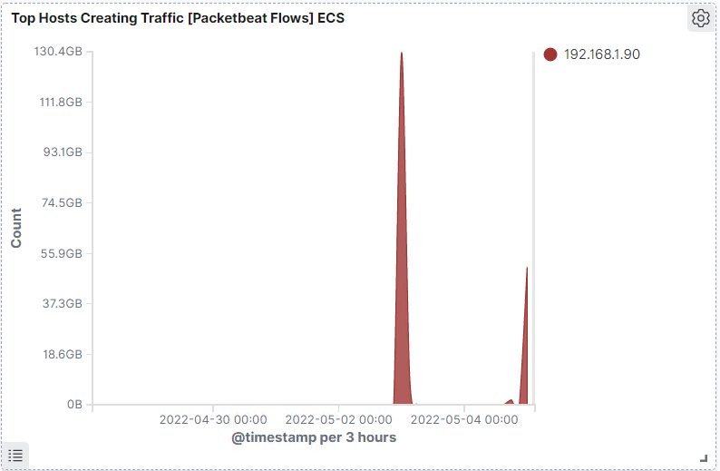
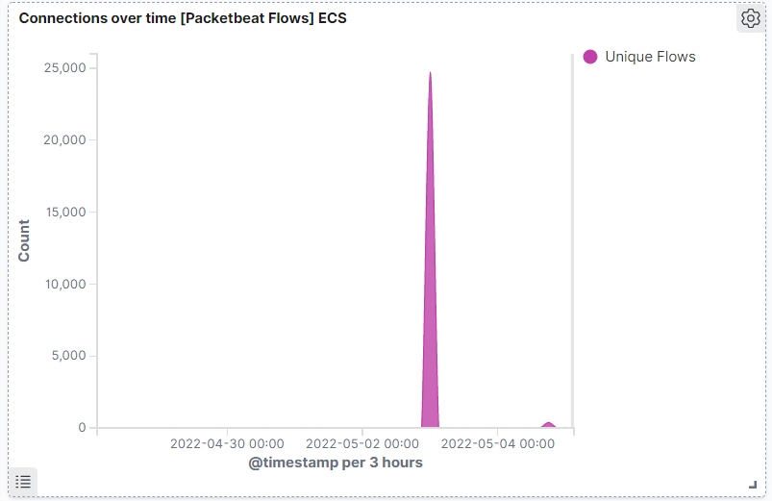
Brute Force Continued
There was a total of 16550 request made.
There were 16534 request made before the attacker discovered the password.

Slide 29
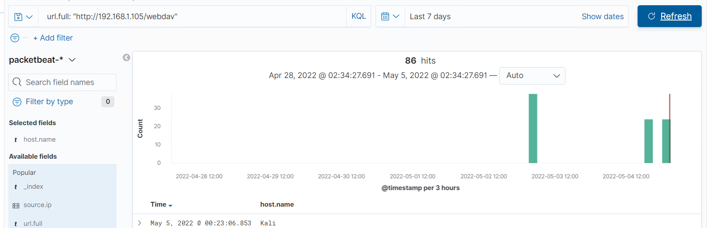
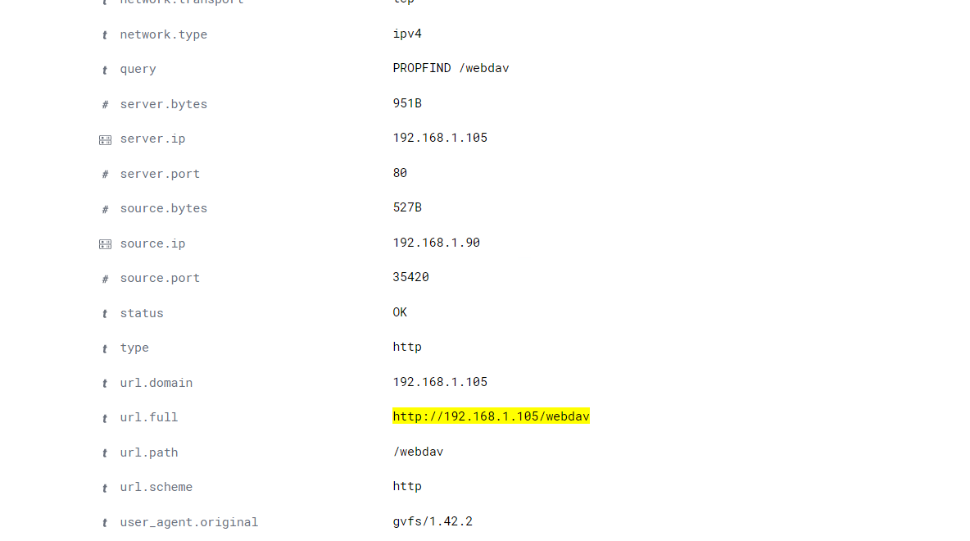
Analysis: Finding the WebDAV Connection
There were 86 requests sent to this directory.
The files requested were the /webdav/open-shell.php

Slide 30
Blue Team
Proposed Alarms and Mitigation Strategies
‹#›

Slide 31
Mitigation: Blocking the Port Scan
To alert the SOC when there are multiple ports being scanned quickly.
The threshold that I would use is 8 requests per second for more than 4 seconds.
You can Set up a firewall rule that keeps Ports 80, 4444 closed. When not in authorized use. You could also whitelist IP addresses.
You would go into your firewall rules page and then write the rules to close all ports and then you could add your list of whitelisted IP address. Another thing you could do if some ports couldn’t be closed is create a honeypot that catches all unwanted scans.

Slide 32
Mitigation: Finding the Request for the Hidden Directory
Set an alarm that goes to the SOC when there is an attempt to access the “secret_folder” from an unauthorized IP address.
The threshold that I would put for this alert would be >0.
Remove the path to the “secret_folder” off the server. Change the name from “secret_folder” to something less suspicious. Restrict access.
Modify the configuration file in /var/www to only grant access to the directory to specific IP address.
Use the rename command to change directory name.

Slide 33
Mitigation: Preventing Brute Force Attacks
Set an alert to the SOC for suspicious loggins or when a known malicious program such as Hydra is used.
The threshold to activate alert would be 5 bad attempts in 1 minute.
Have a stronger password police that takes into account password length, complexity and reuse.
Implement 2 factor authentication, either using something you have or something you know.

Slide 34
Mitigation: Detecting the WebDAV Connection
Alert SOC when a Non trusted IP attempts to access Webdav.
The threshold to trigger this alert would be >0.
Limit access to a small number of admin, and block all external IPs. Require multi-factor authentication to access webdav.

Slide 35
Mitigation: Identifying Reverse Shell Uploads
Notify SOC when a Put request is made from an untrusted IP address.
The threshold to trigger alarm should be >0 from untrusted IP addresses.
Modify the config file to block all non trusted IP Addresses.
This can be done in the /var/www directory by limiting IP address that can access the Webdav folder. And then only allowing admins to have the write privilege.

